Slide 1

MEASI
COLLEGE OF EDUCATION – 10209
No.2, Demellows Road, Choolai, Chennai- 600112
(Affiliated to TAMILNADU TEACHERS EDUCATION UNIVERSITY)

Slide 2
Presented by
Dr. A. Pareet jayadevi assistant professor
COURSE – 9
ASSESSMENT FOR LEARNING
Unit – I
BASICS OF ASSESMENT
Topic
ROLE OF ASSESSMENT IN LEARNING

Slide 3
ASSESSMENT FOR
LEARNING

Slide 4
Assessment for Learning
OBJECTIVES
To describe the meaning and role of assessment
To know the principles of assessment practices
To understand the assessment practices in various approaches of teaching
To Differentiate different types of assessment
To understand how to prepare report for assessment findings

Slide 5

BASICS OF ASSESSMENT– Unit 1
Learning Outcomes
To recognize the meaning of Measurement, Assessment and Evaluation
To understand the relationship of Measurement, Assessment and Evaluation
To assess the educational objectives while learning
To develop the skill to use appropriate assessment strategies for learning.

Slide 6


This presentation discusses
Basics of Assessment
Association with Assessment , Measurement and Evaluation
Role of Assessment in Learning
Assessment for Learning

Slide 7
Measurement

Slide 8





Suppose there is a basket full of fruits. Let us count the fruits.
There are 22 , 12 16 4 , 8 In all there are 62 fruits in the basket.
This counting is called Enumeration.
Now, if someone asks “what is the total weight of the basket?”
When the basket is weighed, we find that is 6.5 kg. This weighting answers the question “How much”.
So when we are trying to answer the question “How much” i.e. how much height, how much time, how much area, how much volume, how much pressure, how much water, how much electricity etc., we are dealing with measurement.
Measurement answers the question “how much”.

Slide 9
In every measurement, 3 things are involved,
Firstly a set of objects i.e. the thing, object or person to be measured,
Secondly a set of numbers and
Thirdly a rule or rules for the assignment of a number to each object.
In education, student’s progress is measured in terms of
marks or grades
teacher’s effectiveness as
improvement and modification of the
behaviour of his students etc.

Slide 10
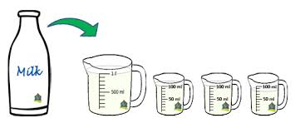
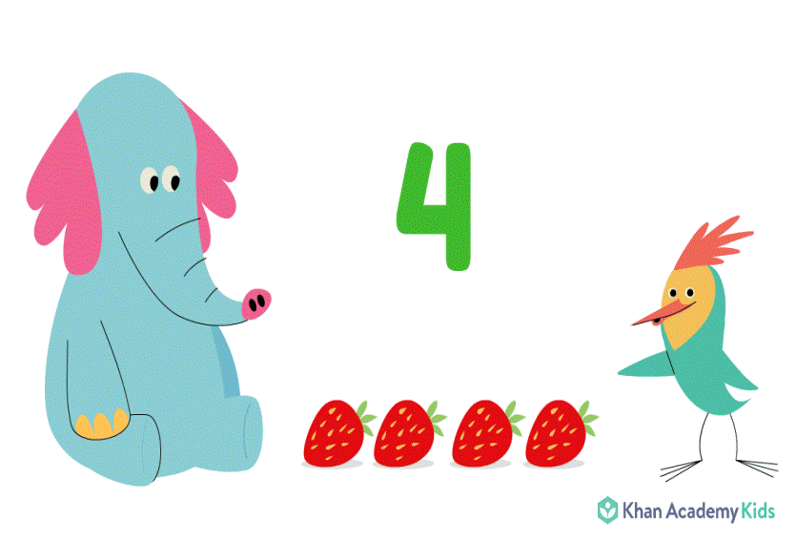
Measurement - Definition
Measurement refers to the process of assigning numerals to events, objects etc. according to certain rules (Tyler, 1963).
Measurement consists of rules for assigning numbers to objects in such a way as to represent quantities of attributes (Nunnally, 1970).

Slide 11
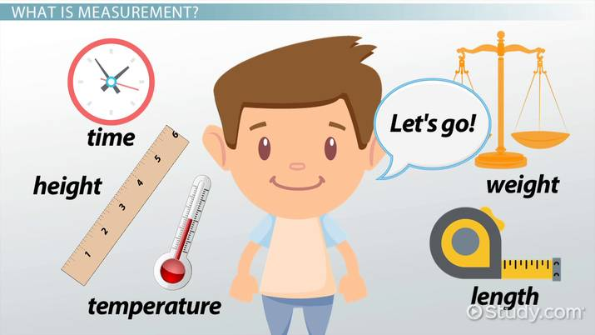
Measurement
According to Norman E Ground (1985):
“Measurement is the process of obtaining a numarical description of the degree to which an individual possesses a particular characteristic.”
According to Ebel & Frisbie (1991):
“Measurement is the process of assigning numbers to individuals or their characteristics according to specified rules.”

Slide 12
Assessment

Slide 13
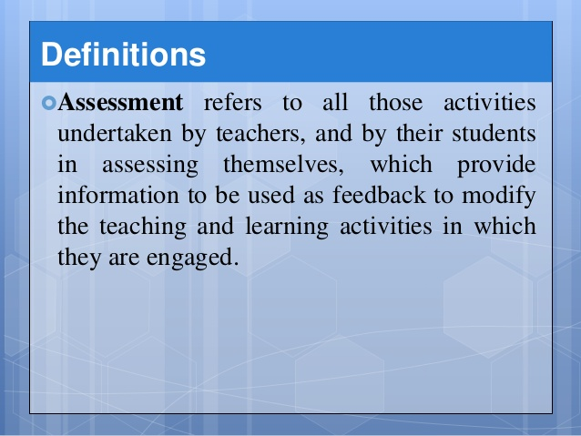

Slide 14
According to Evangeline Harris Stefankis (2002),
“The word assess comes from the Latin
assidere, which means to set beside.
According to Fenton (1996),
“Assessment is the collection of relevant information

Slide 15
Evaluation

Slide 16

Evaluation
“A systematic process of determining what the actual outcomes are but it also involves judgment of desirability of whatever outcomes are demonstrated.” (Travers, 1955)
“ The process of delineating, obtaining and providing useful information for judging decision alternatives” (Stufflebeam et al 1971)

Slide 17
The Purposes of Evaluation
According to Oguniyi (1984)
To determine the relative effectiveness of the programme in terms of students’ behavioural output;
To make reliable decisions about educational planning;
To identify students’ growth or lack of growth in acquiring desirable knowledge, skills, attitudes and societal values;
To identify problems

Slide 18
The Purposes of Evaluation
(..Cont)
To help teachers determine the effectiveness of their teaching techniques and learning materials;
To help motivate students
To predict the general trend in the development of the teaching-learning process;

Slide 19
Steps Involved in Making an Evaluation
Define the objective or the purpose of the test.
Measure the performance or administer the test.
Find or develop a standard.
Compare a person’s performance on the test to a standard.
Make the evaluation then discuss and distribute the results in the most appropriate manner.

Slide 20
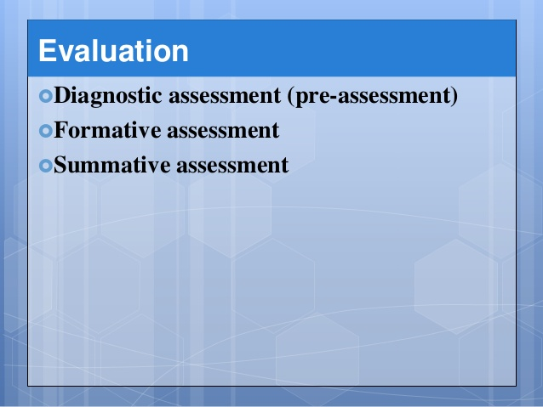


Slide 21
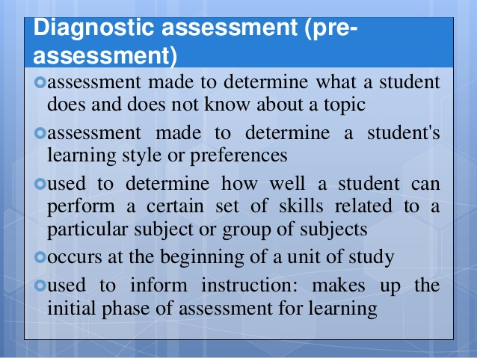

Slide 22


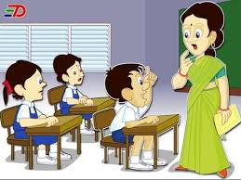
ஒரு மாணவன் எவ்வாறு கற்கிறான்
How a Student Learns
இலக்குகள்
Goals
முன்னேற்றம்
Improvement
ஒரு மாணவன் என்ன அறிந்துள்ளான்
What a Student Knows
Teacher Should Know

Slide 23
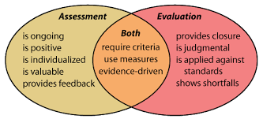

Slide 24
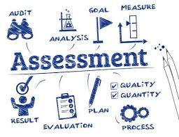

Slide 25
Assessment for Learning
Educational assessment is the process of documenting, usually in measurable terms,
knowledge, skills, attitudes and beliefs.
Assessment can focus on the individual learner, the learning community (class, workshop or other organized group of learners), the institution, or the educational system as a whole.

Slide 26
Functions of Assessment
Gibbs (2003) states that assessment has 6 main functions:
Capturing student time and attention
Generating learning activity
providing timely feedback
Helping students to internalise the discipline’s standards and notions of equality
Generating marks or grades
Providing evidence

Slide 27
Functions of Assessment
Gibbs (2003) states that assessment has 6 main functions:
1. Capturing student time and attention
2. Generating appropriate student learning activity
3. providing timely feedback which students pay attention to
4. Helping students to internalise the discipline’s standards and notions of equality
5. Generating marks or grades which distinguish between students or enable pass/fail decisions to be made
6. Providing evidence for other outside the course to enable them to judge the appropriateness of standards on the course. That may be relied on for making decisions.

Slide 28

Nature of Assessment
Assessment is embedded in the learning process. It is tightly interconnected with curriculum and instruction.
As teachers and students work towards the achievement of curriculum outcomes, assessment plays a constant role in informing instruction, guiding the student’s next steps, and checking progress and achievement.

Slide 29

Outcomes of Assessment in teacher’s mind
Teachers use many different processes and strategies for classroom assessment, and adapt them to suit the assessment purpose and needs of individual students.

Slide 30
Role of Assessment in Learning
Assessment for learning
Assessment as learning
Assessment of learning

Slide 31
Assessment
for Learning
where assessment helps teachers gain insight into what students understand in order to plan and guide instruction, and provide helpful feedback to students.
as learning
where students develop an awareness of how they learn and use that awareness to adjust and advance their learning, taking an increased responsibility for their learning.
of learning
where assessment informs students, teachers and parents, as well as thebroader educational community, of achievement at a certain point in time

Slide 32
Assessment for learning
Assessment for learning occurs at all stages of the learning process
Students are guided on what they are expected to learn
and what quality work looks like.

Slide 33

Assessment for learning
The ultimate purpose of assessment for learning is
to create self-regulated learners who can
leave school able and
confident to continue learning throughout
their lives.

Slide 34

Assessment for learning includes
day-to-day activities, such as learning conversations
a simple mental note taken by the teacher during observation, student self and peer assessments, a detailed analysis of a student’s work assessment tools, which may be written items, structured interview questions, or items teachers make up themselves.

Slide 35
Assessment for learning
comprises two phases—initial or diagnostic assessment and formative assessment
assessment can be based on a variety of information sources (e.g., portfolios, works in progress, teacher observation, conversation)
verbal or written feedback to the student is primarily descriptive and emphasizes strengths, identifies challenges, and points to next steps

Slide 36
Assessment for learning
as teachers check on understanding they adjust their instruction to keep students on track
no grades or scores are given - record-keeping is primarily anecdotal and descriptive
occurs throughout the learning process, from the outset of the course of study to the time of summative assessment

Slide 37
Assessment for learning
Teachers need to know
and then
at the outset of a unit of study where their students are in terms of their learning
continually check on how they are progressing through strengthening the feedback they get from their learners.

Slide 38

Assessment for learning
The teacher will work with the student to understand and identify any gaps or misconceptions
As the unit progresses, the teacher and student work together to assess the student’s knowledge, what she or he needs to learn to improve and extend this knowledge, and how the student can best get to that point

Slide 39
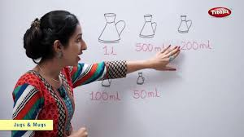

Assessment for learning
Assessment for learning is best described as a process by which assessment information is used
by teachers to adjust their teaching
strategies,
and
by students to adjust their
learning strategies.

Slide 40

Assessment for learning
In classrooms where assessment for learning is practiced,
students are encouraged to be more active in
their learning and associated assessment.

Slide 41
Principles of Assessment for Learning
The active involvement in learning
Adjustment teaching
Recognition
Self-evaluation
Effective Feedback

Slide 42
For teachers
plan and modify teaching and learning programmes for individual students, groups of students, and the class as a whole.
pinpoint students’ strengths so that both teachers and students can build on them.
identify students’ learning needs in a clear and constructive way so they can be addressed.
involve parents, families engaging in their children's learning.

Slide 43



For students
provides students with information and guidance so they can plan and manage the next steps in their learning.
uses information to lead from what has been learned to what needs to be learned next.

Slide 44
Assessment as learning
Assessment as learning begins as students become aware of the goals of instruction
and the criteria for performance involves goal-setting, monitoring progress, and
reflecting on results implies student ownership and responsibility for moving his or her thinking forward (metacognition)
occurs throughout the learning process

Slide 45
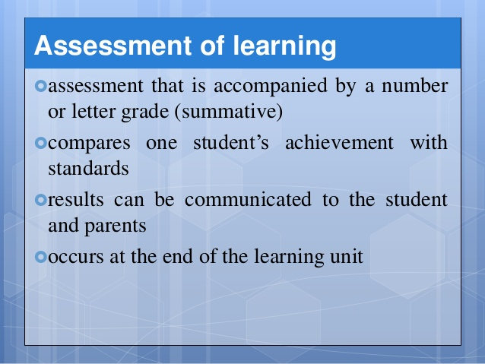


Slide 46
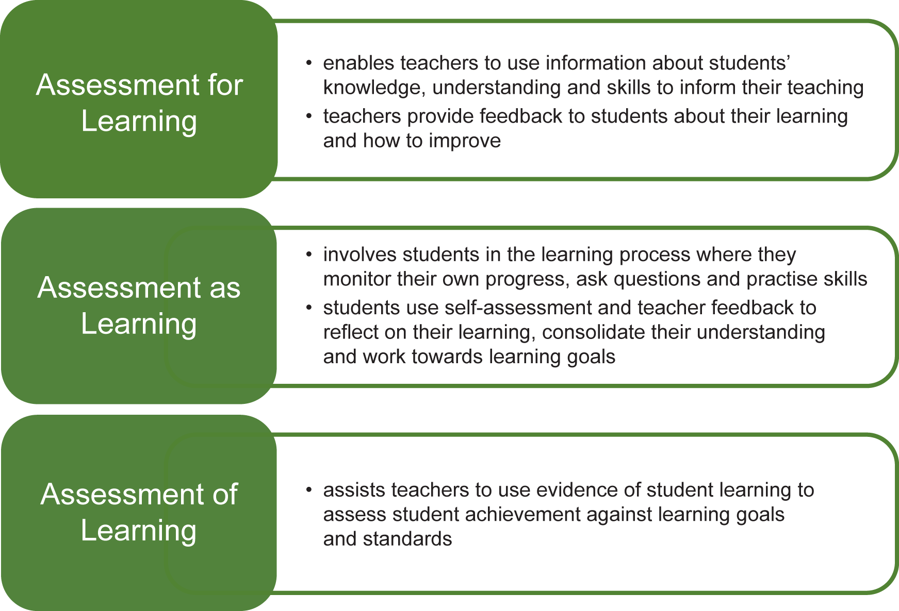

Slide 47
References
Bhatia,K.K.(1985), ‘Measurement and Evaluation in Education, Prakash Brothers, Ludhiana.
Nagarajan. (2017), Assessment for Learning, Sriram publications, Chennai
Dr.V.Sharmila, Assessment for Learning, TNTEU study material, Chennai
www.edb.gov.hk/en/curriculum/assessment/assessment-for-learning

Slide 48


